Slide 1

SENIOR CAPSTONE CHECKPOINT 3/MIDTERM
OmniGuard SOC
Autonomous Multi-Modal Threat Defense, Jitter-Invariant C2 Analytics
& Graph-Based Incident Triage
PRIMARY DOMAINS
TARGET INFRASTRUCTURE
TARGET COMPLETION
AI/ML, SecOps & Cloud
IBM LinuxONE, AWS & On-Prem
December 2026 (12–14 Weeks)
Khoi • Rahim • Aayush • Abu

Slide 2


Khoi
THE TEAM
Roles & Responsibilities (1/2)
Khoi
Rahim
Encrypted C2 Behavioral Engine & Telemetry Pipeline
Visual Ingress Defense & Adversary Emulation
Build the SpectraC2 flow-metadata pipeline on IBM LinuxONE (s390x): IAT variance, packet symmetry, spectral density
Train and tune the FFT/PSD feature extractor and LSTM classifier that isolate jittered C2 beacons
Stand up the Kafka/Redis ingestion layer and Zeek/Suricata telemetry parsers feeding the graph engine
Develop the VerifyEye engine: YOLOv8/pHash brand-logo detection and Playwright DOM crawler
Build the Chrome MV3 extension for real-time credential form locking on unverified submissions
Script Flipper Zero BadUSB / rogue captive-portal scenarios and configure the Sliver C2 listener

Slide 3


Khoi
THE TEAM
Roles & Responsibilities (2/2)
Abu
Aayush
Graph Correlation & Air-Gapped LLM Triage
Unified Dashboard & Platform Integration
Design the Neo4j property-graph schema and entity resolution for hosts, users, IPs and processes
Implement shortest-path, blast-radius and centrality algorithms in Cypher / NetworkX
Deploy the air-gapped Ollama (Llama-3-Cyber) triage layer and MITRE ATT&CK mapping prompts
Build the React / React Flow / D3.js SOC dashboard: attack graphs, FFT heatmaps, timeline playback
Wire WebSocket streaming for sub-second alert delivery across all three engines
Own AWS ECS/Lambda deployment and end-to-end integration across the five project phases

Slide 4
Khoi
The Crisis in Modern SOC: 3 critical blind spots
The Zero-Hour Phishing Gap: Malicious harvesting domains live for only 4–8 hours. Blacklists take 12–48 hours to update, leaving organizations fully exposed during initial campaigns.
The Encrypted C2 Blind Spot: >95% of traffic is encrypted (TLS 1.3). Attackers inject 10%–50% randomized jitter into beacon loops, completely evading traditional threshold-based firewalls.
Alert Fatigue & Siloed Tools: Analysts face 10,000+ disconnected daily alerts. Relational databases fail to trace multi-hop lateral movement, leaving dwell times over 16 days.
⇒ OmniGuard eliminates point-solution sprawl by unifying browser-level ingress, wire-level network telemetry, and graph-based response into one platform.

Slide 5
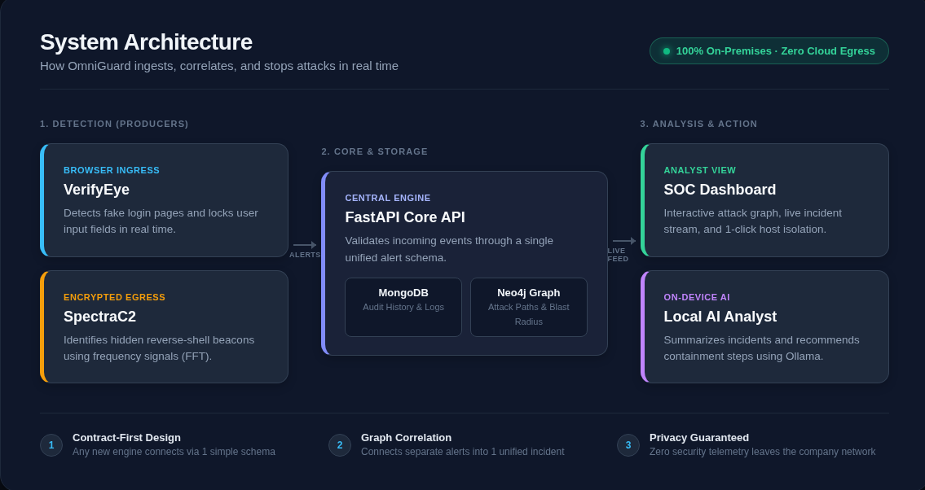
Khoi
OmniGuard System Architecture

Slide 6
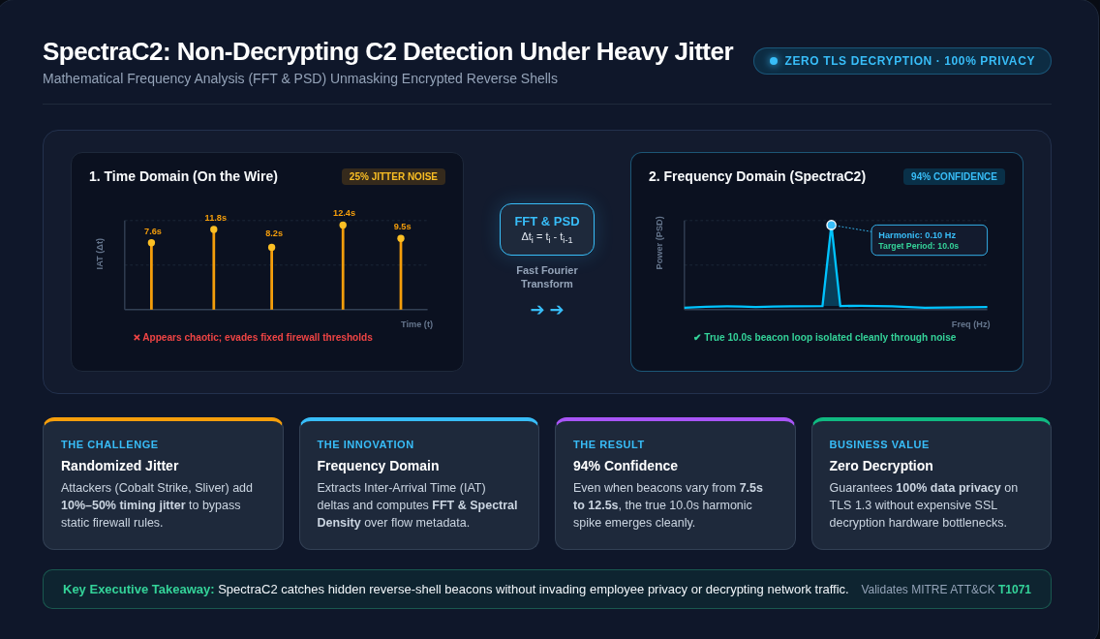
Khoi

Slide 7
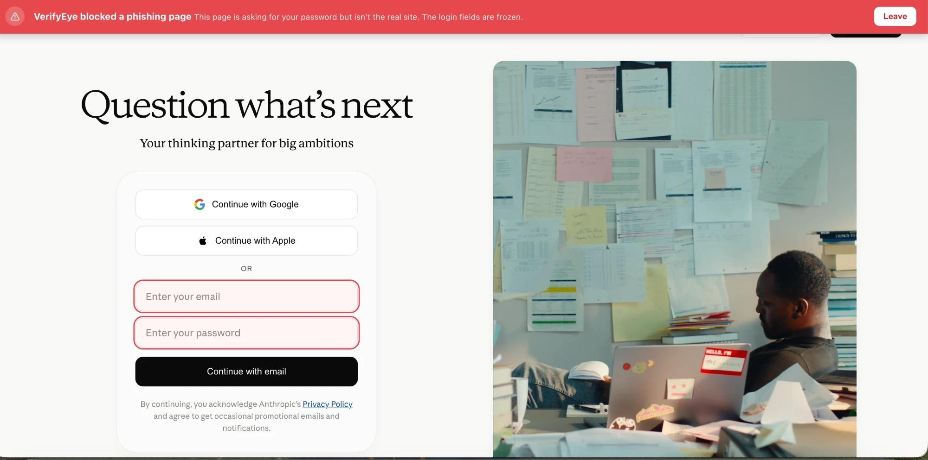
Rahim
VerifyEye: zero-hour browser defense
Catches phishing in the browser before credentials leave the device.
Surgical freeze—locks the login fields and submit, drops a warning banner
Network block—kills exfiltration
even if a script bypasses the form
Fig : Fake Claude page to test VerifyEye

Slide 8
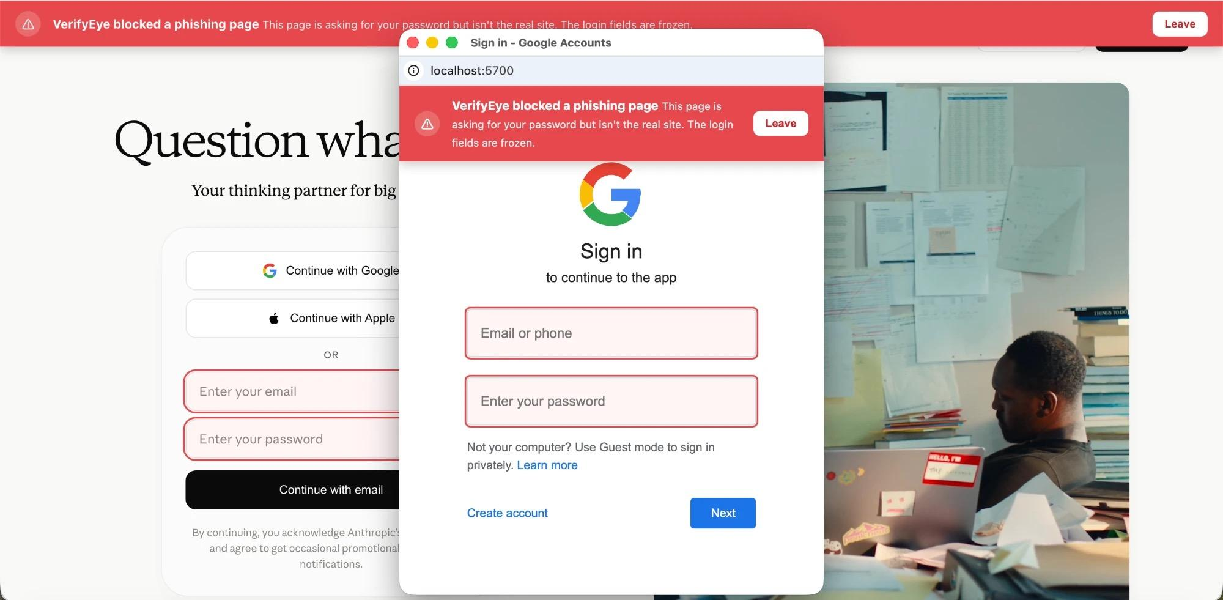
Rahim
VerifyEye: beating the evasions
Fake OAuth popups — caught the instant they open
Late/single-page-appforms—caught by a live DOM watcher
10 brands, defined centrally
Fig : Fake Claude page with google pop-up to test VerifyEye

Slide 9
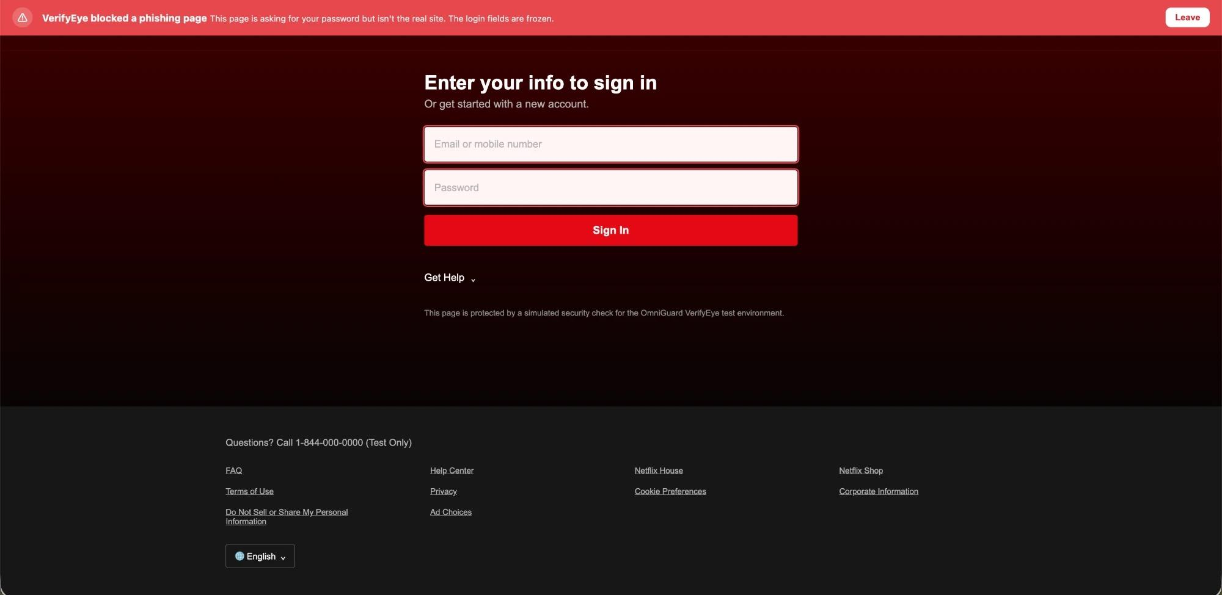
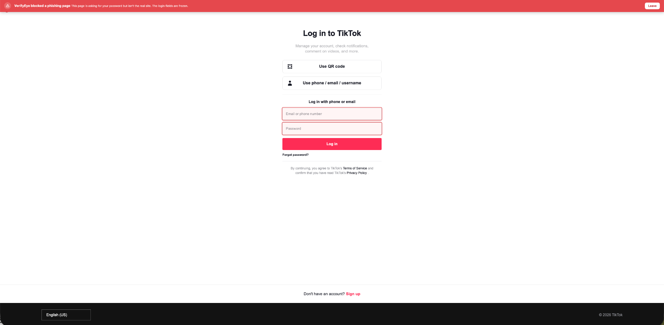
Rahim
VerifyEye: more examples
Fig : Fake Netflix page to test VerifyEye
Fig : Fake TikTok page to test VerifyEye

Slide 10
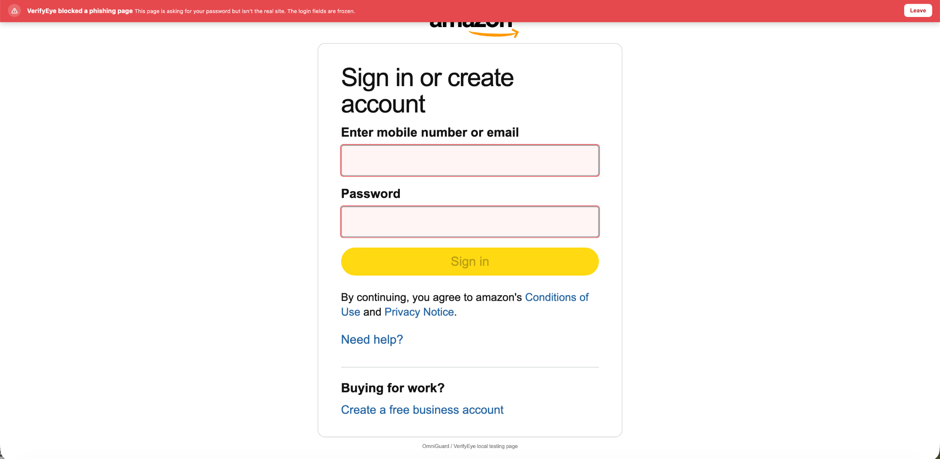
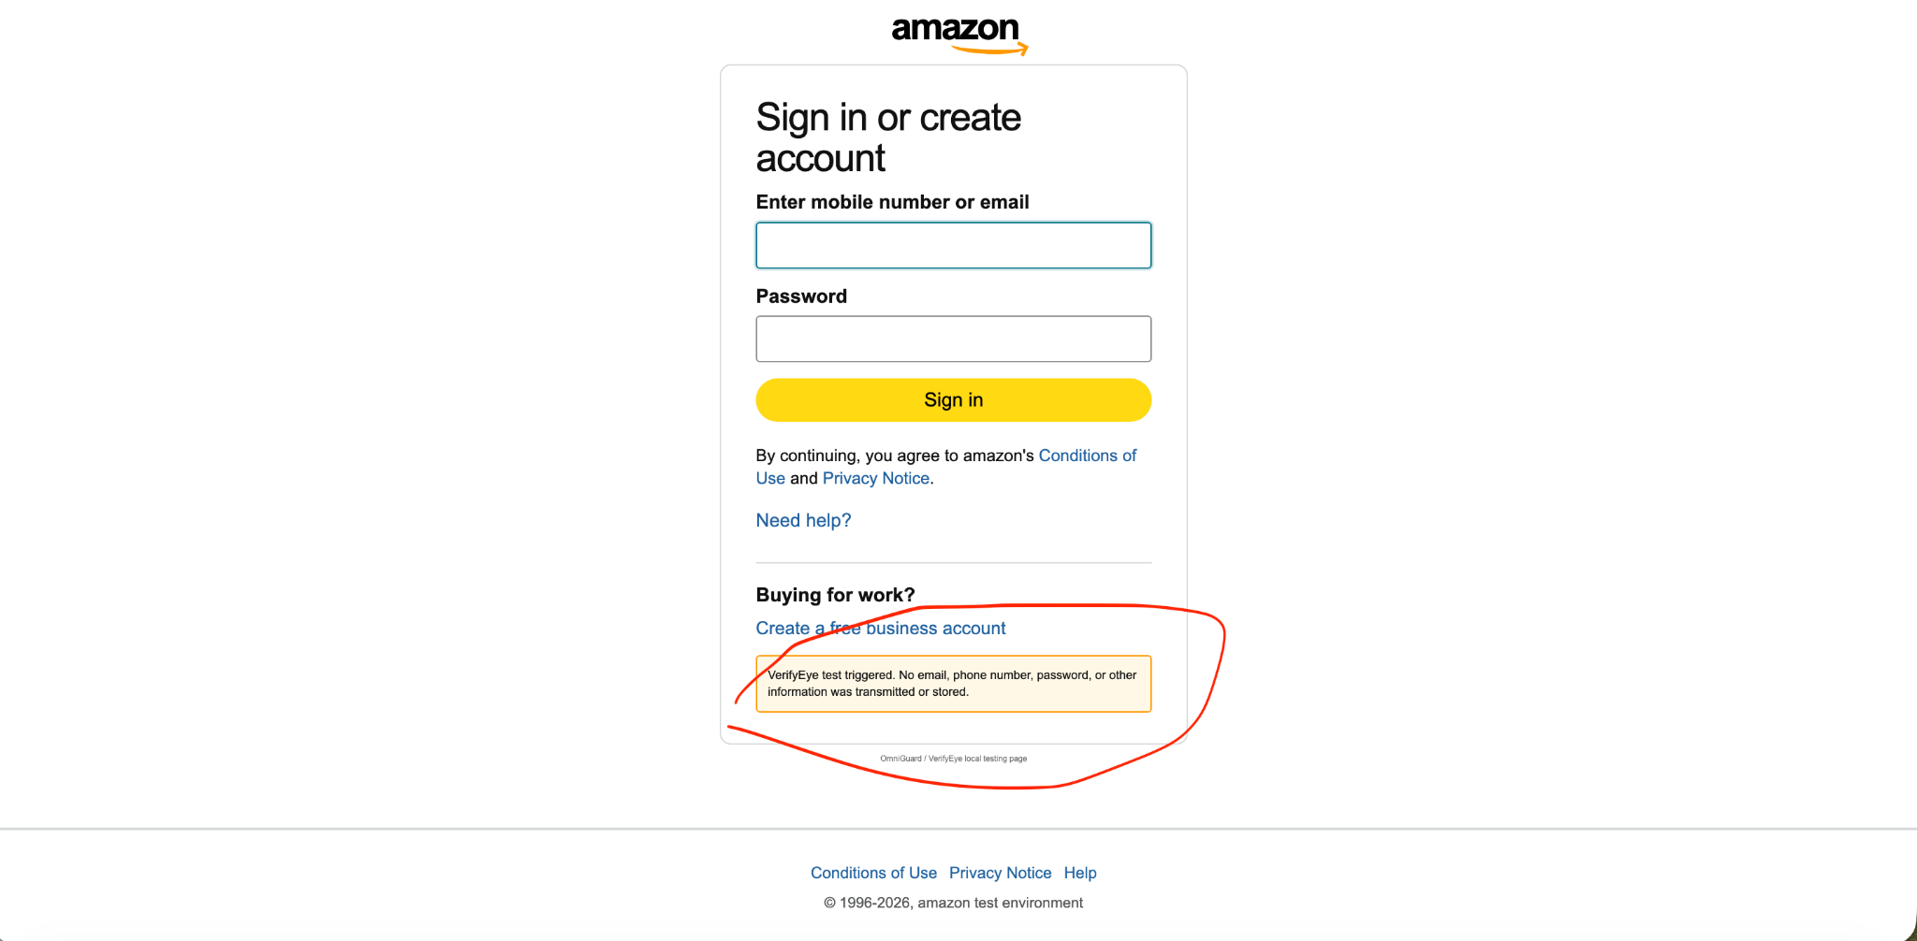
Rahim
VerifyEye: more examples
Fig.: Fake Amazon page to test VerifyEye. In the first screenshot we have VerifyEye zero-hour phishing detection freezing the credentials. Even if the page somehow manages to fight our first layer, we have another layer that doesn’t submit the credentials to a fake suspicious domain and blocks all the submission on forms.

Slide 11
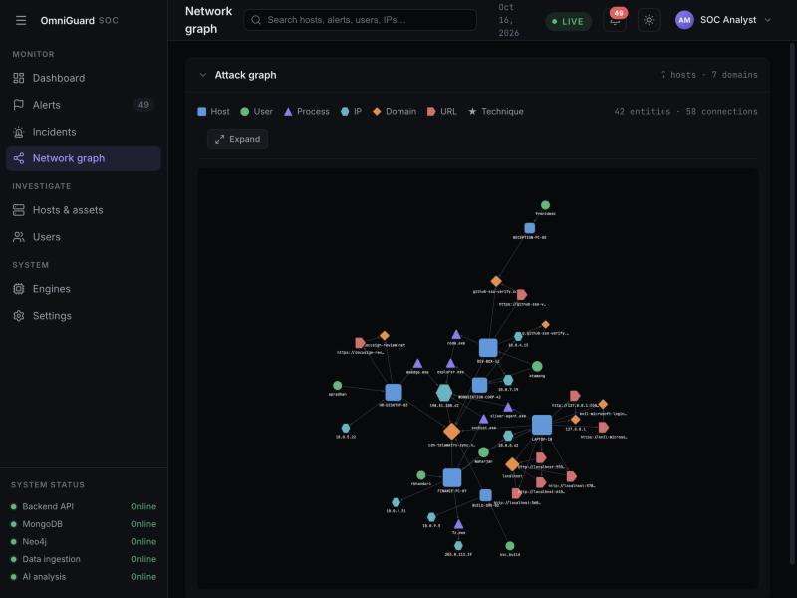
From scattered alerts to one incident
Abu
Links hosts, users, domains, IPs, and URLs
See which machines touch the same bad infrastructure
An investigation tool not just a display of alerts.
Fig : Graph showing hosts, users, domains, IPs, URLS

Slide 12
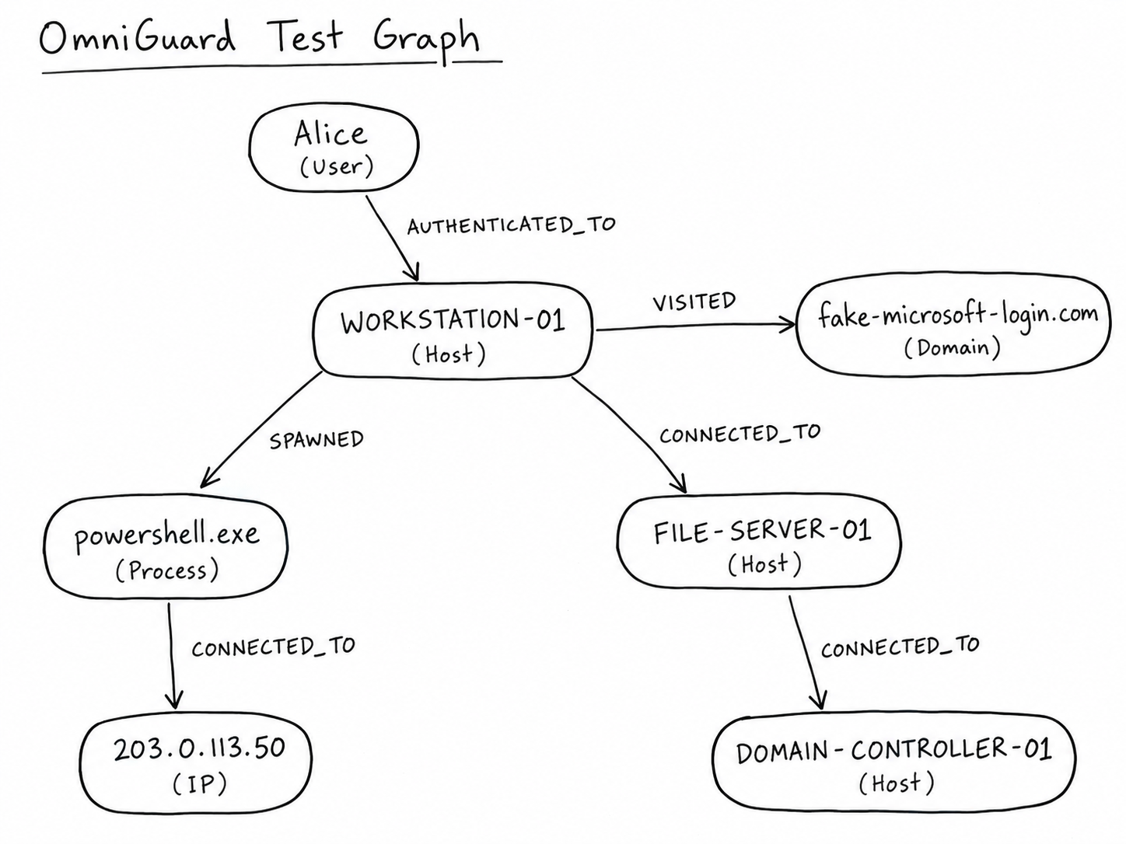
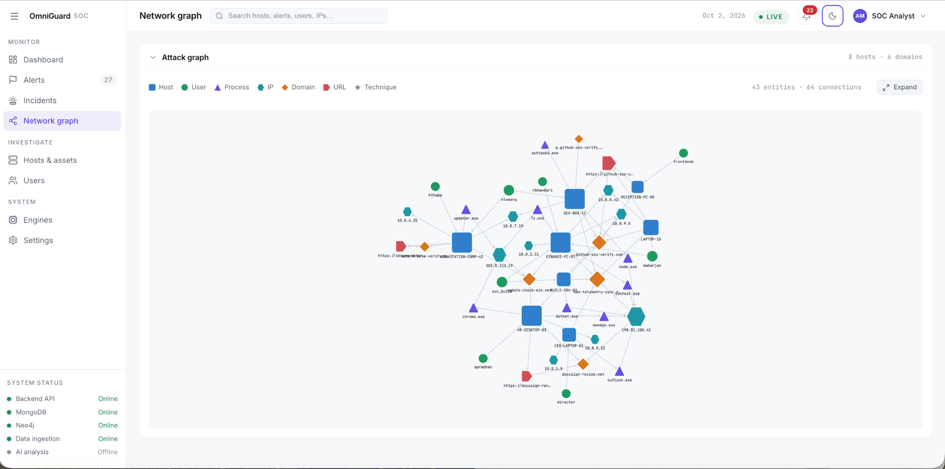
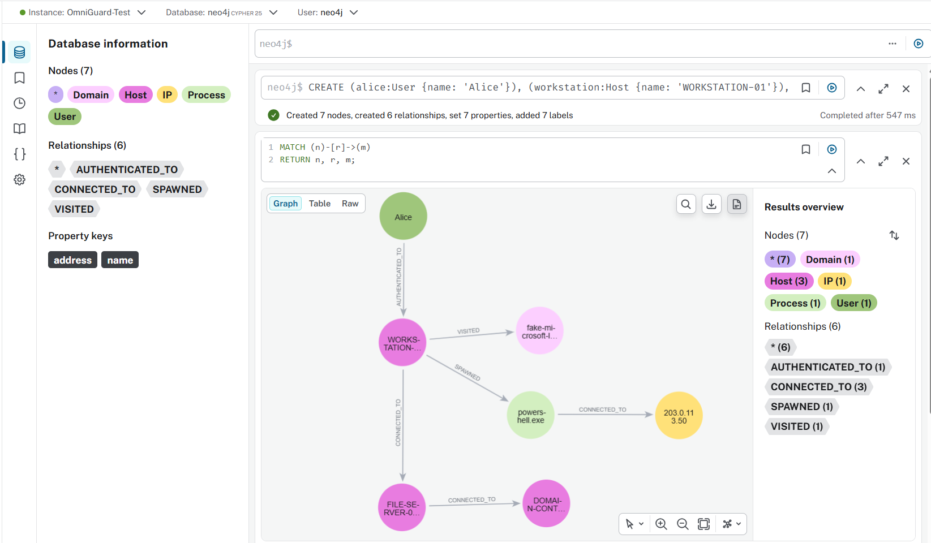
From scratched to one Fully scaled Graph
Abu
Fig : Graph showing hosts, users, domains, IPs, URLS more closely

Slide 13
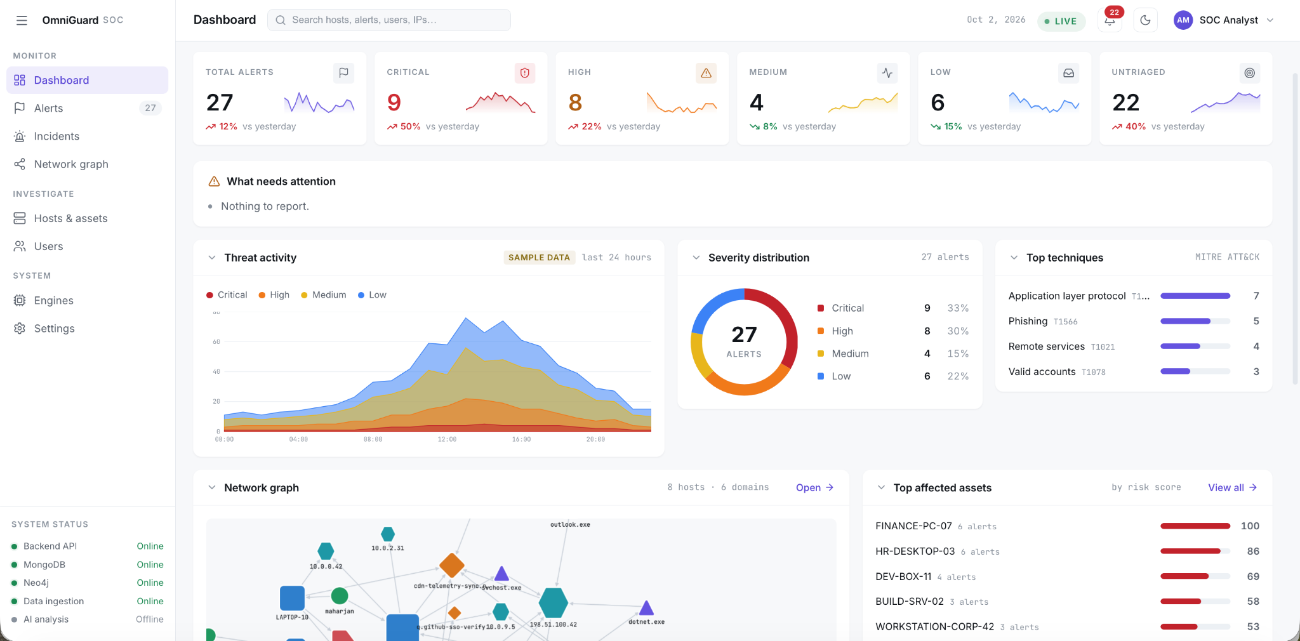
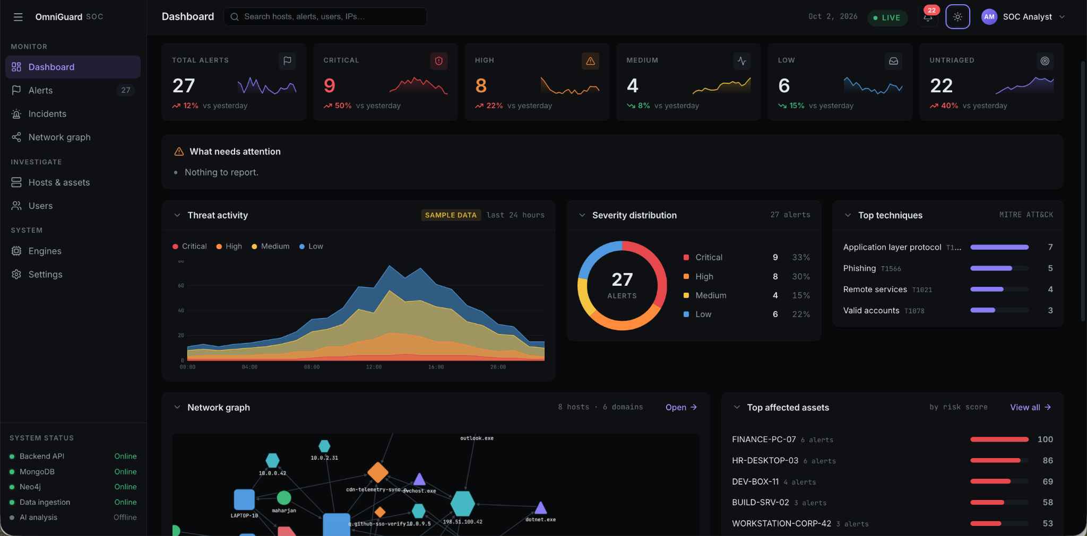
A Complete Dashboard Design
Abu
Reads every recent alert
Shows all the alerts
Prioritize the criticalness
Uses different types of charts

Slide 14
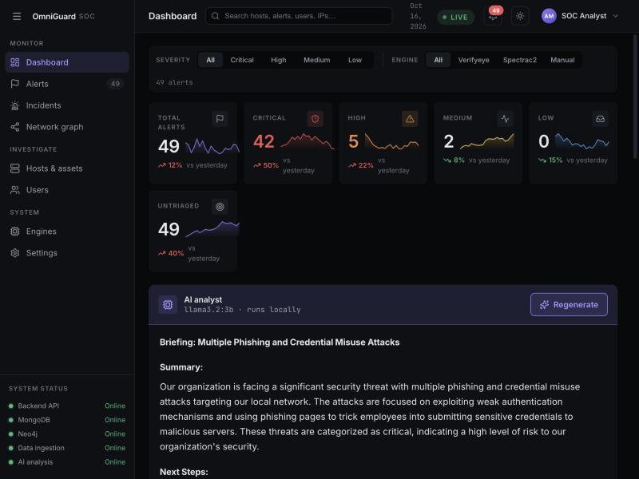
Abu
A local AI analyst
Reads every recent alert
Writes a summary + prioritized next steps
Runs on-device—nothing leaves the machine
Fig : Screenshot shows AI-generated summary.

Slide 15
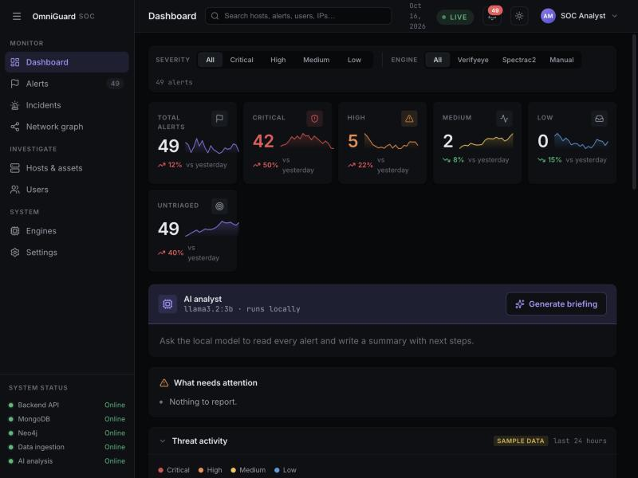
Abu
The unified dashboard
Live alerts over WebSocket—no refresh
Real system health monitor (polls every 10 s)
Trends, activity, graph, AI—one screen
Fig : Screenshot showing the dashboard overview.

Slide 16
Aayush
End-to-end, live
Manual signals for testing/spectra 2/Phishing page frozen → Alert to core → Stored + correlated → AI briefs the analyst
A fake login is frozen in the browser → an alert fires → instantly on the dashboard (live, no refresh)
The core stores the full record in MongoDB and links its entities in Neo4j
The local AI reads it and briefs the analyst—all on-device, zero cloud egress

Slide 17
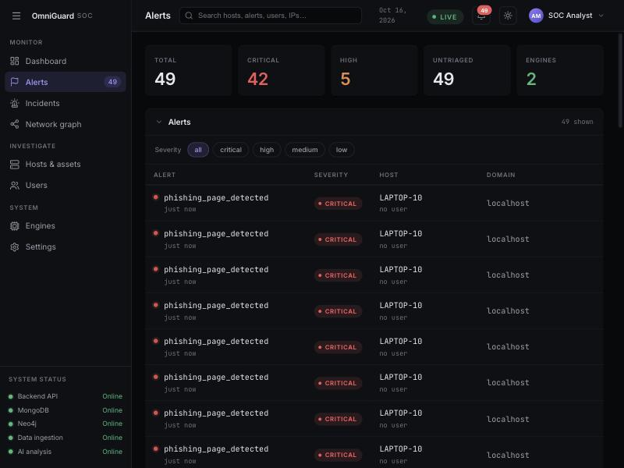
Aayush
End-to-end, part 1
Phishing page frozen → Alert fired → Live on the dashboard
Fig : Screenshot showing the VerifyEye freezing the login.
Fig : Screenshot showing the dashboard showing the same alert showing up.

Slide 18
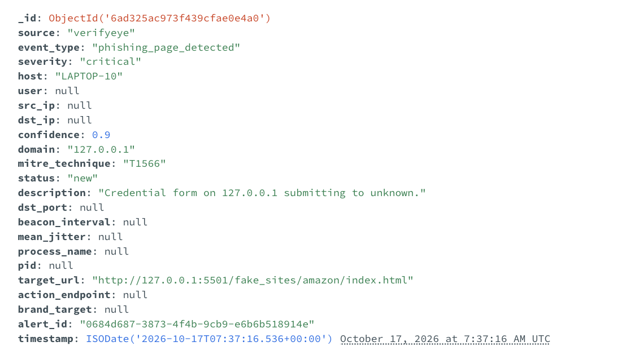
Aayush
End-to-end, part 2a
Core API → MongoDB (full record) + Neo4j (entities) → AI briefing
Fig : Screenshot showing the post endpoint being valid.
Fig : Screenshot showing the alert landing on our mongoDB.

Slide 19
Aayush
End-to-end, part 2b
Core API → MongoDB (full record) + Neo4j (entities) → AI briefing
Fig : Screenshot showing the graph being drawn after alert is posted.
Fig : Screenshot showing the AI summary for all the alerts that we have in the system.

Slide 20
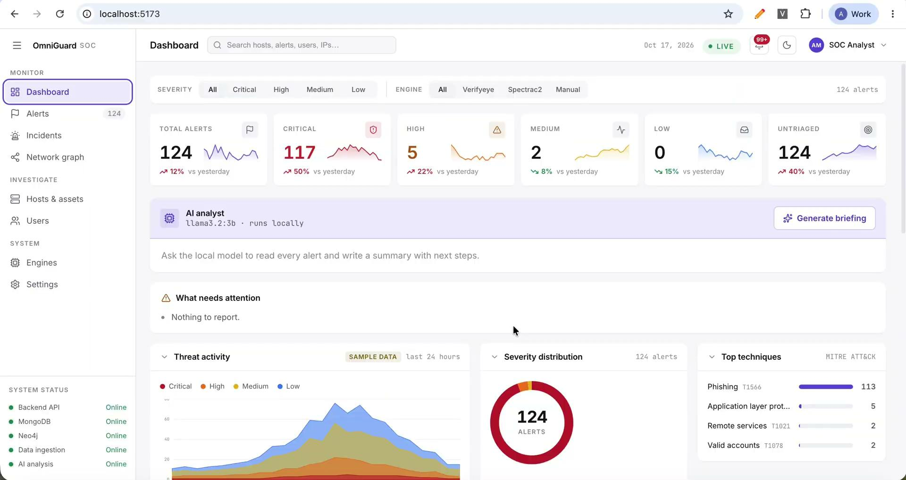
Aayush
Quick Demo
Video: Video showing the end-to-end demo of the whole product.

Slide 21
Abu
Milestones
Phase | Focus | Status
1 | Architecture & alert contract | Done
2 | VerifyEye + core detection | Done
3 | Dashboard, graph, AI triage | Done
4 | SpectraC2, visual tier, chatbot, VerifyEye V2 | In progress
5 | Testing + final demo | In progress

Slide 22


Aayush
Next steps
Deeper detection
Richer Investigation
Encrypted-C2 engine (SpectraC2)
Visual logo detection + confidence
Graph Filtering: time, severity, type
Fast correlation at scale.
AI reasons over everything
Detection to response
Full graphs: users, hosts, IPs.
Ask in plain English and get actions and directions (chat style)
1 click host containment
Access control, search, alerts

Slide 23
